Slide 1
Abnormal detection of Chip Temperature Time Series
GC

Slide 2
Team members
CAO LIANG
GENG LIANGYU

Slide 3
Business objective
During oven testing, the heat will be generated at the burn-in board, and the temperature of chip on the burn-in board detected by sensor will be increased over the testing time
The abnormal chip temperature during the testing period will have different pattern comparing with normal chip
Normal chips will have a pattern of increasing temperature over time, due to the continuous heating of the oven, and faulty chips will have a different temperate pattern
Faulty chips will be identified by using the abnormal temperature pattern detection

Slide 4
Technical objective
Create model to perform unsupervised anomaly detection on temperature data
Label chip as normal or faulty based on model output

Slide 5
Resources
Dataset
Masked data based on the original data from semi-conductor factory
Contains sensor temperature data inside IC chip
Obtained during oven testing interval under similar testing environment
Contains 400 burn-in board, and each board contains 32 x 20 chips
Each chip has 20 temperature reading in 10 minutes interval
Reference code

Slide 6
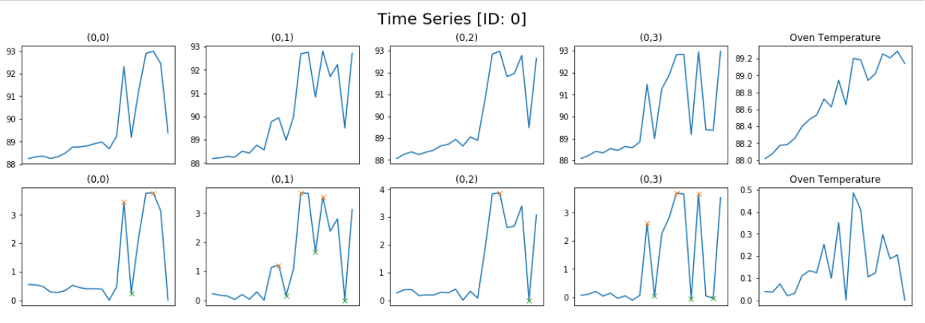
Resources
Dataset

Slide 7
Proposed Approach
Implement unsupervised anomaly detection on temperature time series data
Temperature time series data will be generated by sensor
Train an auto-encoder on the training temperature data
Evaluate it on the validation temperature data and the reconstructed error plot
Choose the threshold and determine the value is abnormal or not
Label chip as faulty if abnormal value is detected

Slide 8
Any other additional comment

